Slide 1

Mepco Schlenk Engineering College (Autonomous)
Electricity Bill Management System
Department of Computer Science and Engineering
<number>

Slide 2
Mepco Schlenk Engineering College (Autonomous)
Problem Description
Approaching electricity department for payments and services are time consuming factor. The traditional way of paying the electricity bill amount to the nearby electricity office is burden and less efficient method. Manually requesting service for electricity issues like low power, fuse blown and short circuit is difficult. It is hard for electricity department to collect feedback from the user for improving their quality of work.
The web based electricity bill management is more efficient as user can pay the bill through the payment protocol as well as can request service if user finds issue with electricity supply.
Department of Computer Science and Engineering
<number>

Slide 3
Mepco Schlenk Engineering College (Autonomous)
Objective
The main objective of this Electricity Bill management System is bridge the gap between Electricity department and user. This application allows the user to pay the electricity bill amount based on consumed units of the user as well as user can directly request service to electricity department through this website.
The administrator of this website can collect and manage the feedback from user as well as disconnect electricity if user has not paid the bill within due date. Moreover, this application allows the user calculate bill using bill calculator and details of the user is also managed by administrator of this application.
If user finds difficult in using the website then user can approach help desk which has all instruction details.
Department of Computer Science and Engineering
<number>

Slide 4
Mepco Schlenk Engineering College (Autonomous)
Outcome
The outcome of this electricity Bill Management System are payment of electricity bill amount made easy and user approaching electricity department as well as managing user details by the electricity department become more reliable.
The user can directly provide feedback to the electricity department through this portal. The user can also directly request service like to resolve fuse blow, low power supply and shorty circuit problem.
It is easy for the electricity department to manage disconnection of electricity if user has not paid the electricity bill within due date.
Department of Computer Science and Engineering
<number>

Slide 5
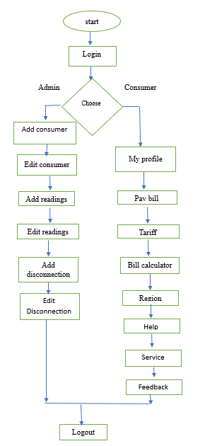
Mepco Schlenk Engineering College (Autonomous)
Flow Diagram of Electricity Bill Management system
Figure 1: Architecture Diagram of Electricity Bill Management System
Department of Computer Science and Engineering
<number>

Slide 6
Mepco Schlenk Engineering College (Autonomous)
Modules
Tables used:
Consumers Table
Readings Table
Disconnection table
Service Table
Feedback table
Department of Computer Science and Engineering
<number>

Slide 7
Mepco Schlenk Engineering College (Autonomous)
Consumers Table
Attribute Name | Type | Constraint(s) | Description
eid | String | Primary key | Consumer Id of the User
Password | String |  | Password of user
Name | String |  | Name of the suer
Address | String |  | Address of the user
Phone | String |  | Phone number of consumer
Department of Computer Science and Engineering
<number>

Slide 8
Mepco Schlenk Engineering College (Autonomous)
Readings Table
Attribute Name | Type | Constraint(s) | Description
eid | String | Foreign key | Consumer id of the user
rid | String |  | Reading id
reading date | String |  | Date in which meter box reading has taken.
due date | String |  | Last date to pay amount.
units | Integer |  | Consumed units of the user
bill | String |  | Amount to be paid by the user
status | String |  | Bill payment status
Department of Computer Science and Engineering
<number>

Slide 9
Mepco Schlenk Engineering College (Autonomous)
Disconnection Table
Attribute Name | Type | Constraint(s) | Description
eid | String | Foreign key | Consumer Id of the User
did | String | Primary key | Disconnection of user
date | String |  | Disconnection date
time | String |  | Disconnection time
reason | String |  | Reason for disconnection
penalityamt | String |  | Fine amount for user
status | String |  | Bill payment status
Department of Computer Science and Engineering
<number>

Slide 10
Mepco Schlenk Engineering College (Autonomous)
Service Table
Attribute Name | Type | Constraint(s) | Description
eid | String | Foreign key | Consumer id of the user
sid | String | Primary key | Service id of the user
complaindate | String |  | Complain date given by user
resolvedate | String |  | Issue resolve date
status | String |  | Resolved or not status
Department of Computer Science and Engineering
<number>

Slide 11
Mepco Schlenk Engineering College (Autonomous)
Feedback table
Attribute Name | Type | Constraint(s) | Description
eid | String | Foreign key | Consumer Id of the User
friendly | String |  | User friendly Rating
design | String |  | User design Rating
desc | String |  | Description by user
rating | Integer | +5 | Rating provided by user
Department of Computer Science and Engineering
<number>

Slide 12
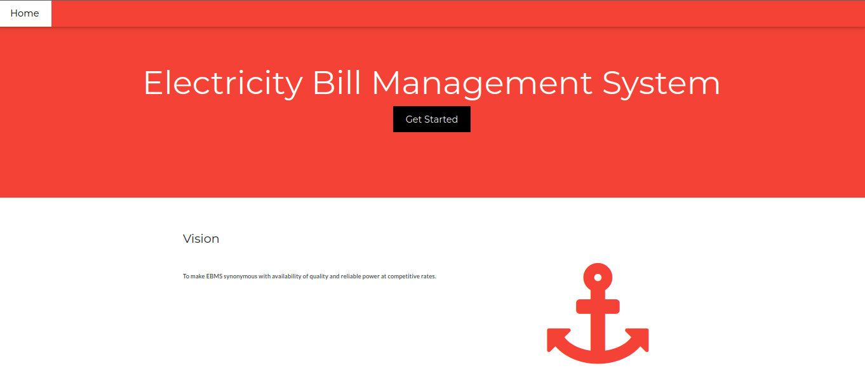
Mepco Schlenk Engineering College (Autonomous)
Results
Figure 2: Home page of Electricity Bill Management System
Department of Computer Science and Engineering
<number>

Slide 13
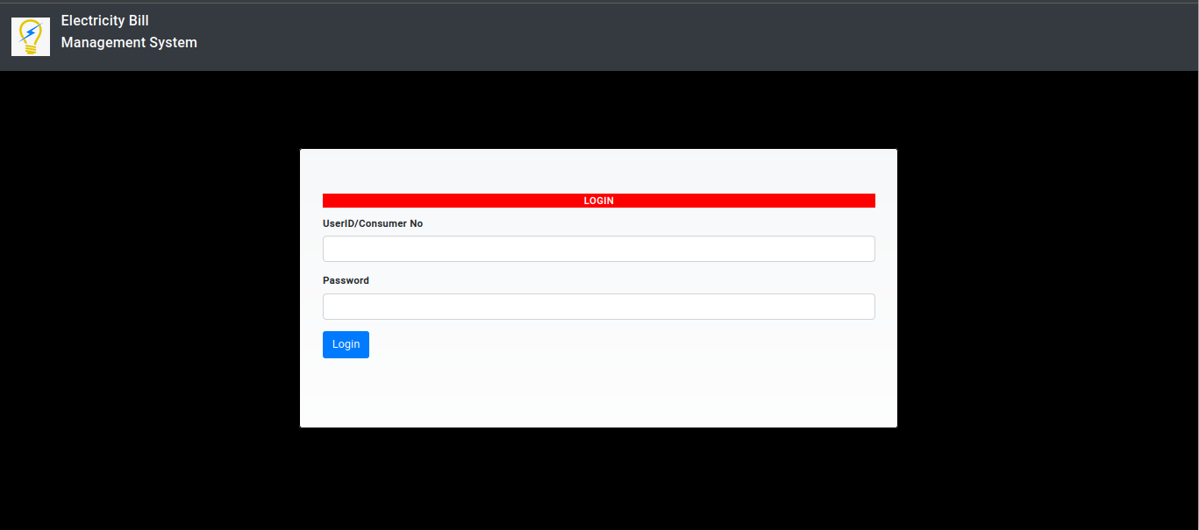
Mepco Schlenk Engineering College (Autonomous)
Login page
Figure 3: Login layout of Electricity Bill Management System
Department of Computer Science and Engineering
<number>

Slide 14
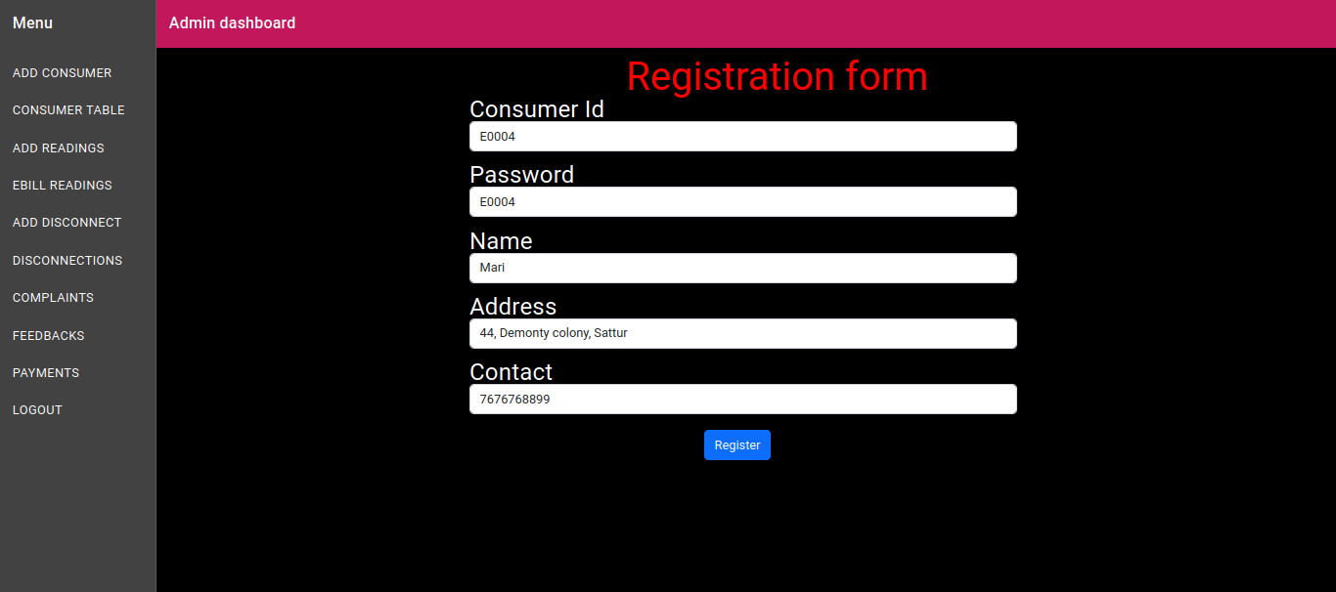
Mepco Schlenk Engineering College (Autonomous)
Registration page
Figure 4: Registration page
Department of Computer Science and Engineering
<number>

Slide 15
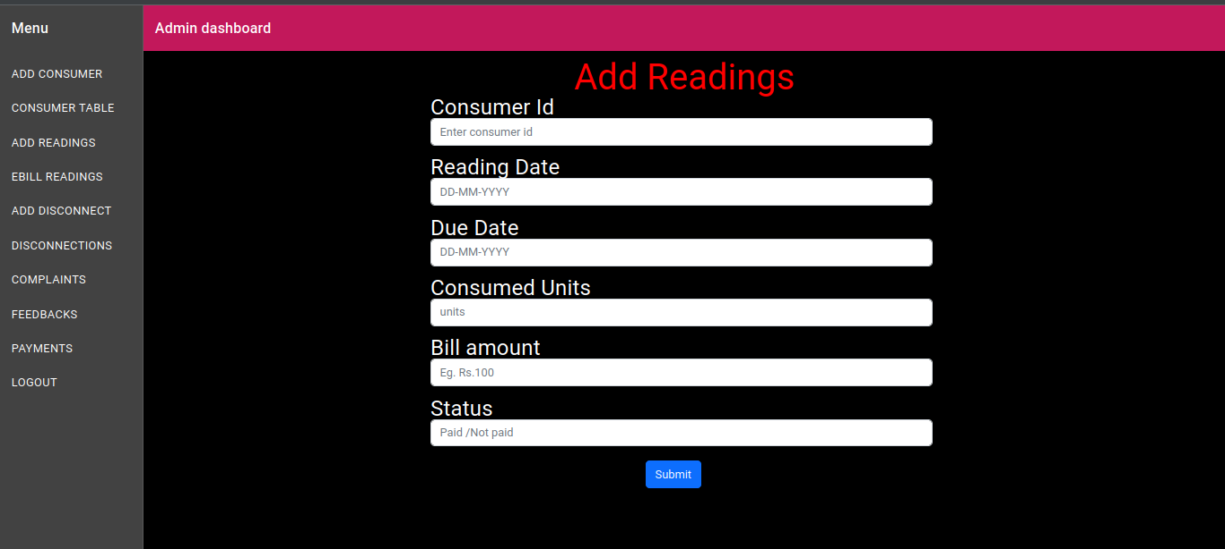
Mepco Schlenk Engineering College (Autonomous)
Reading page
Figure 5: Reading page
Department of Computer Science and Engineering
<number>

Slide 16
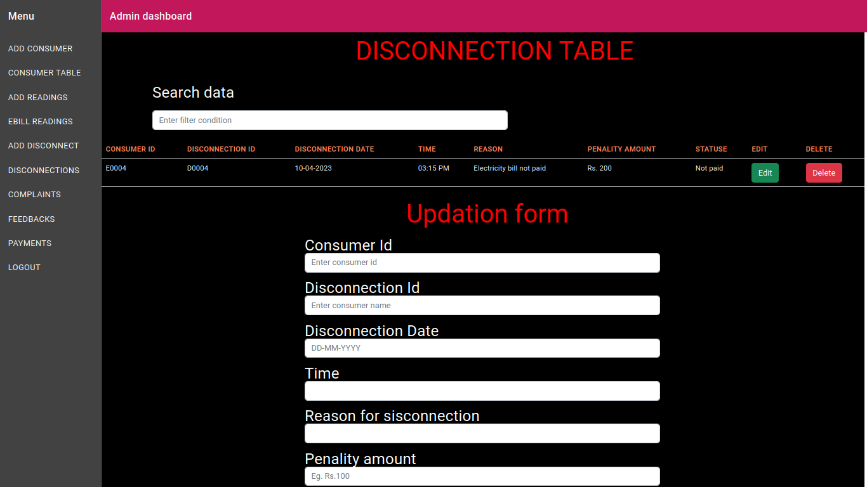
Mepco Schlenk Engineering College (Autonomous)
Disconnection page
Figure 6: Disconnection crud page
Department of Computer Science and Engineering
<number>

Slide 17
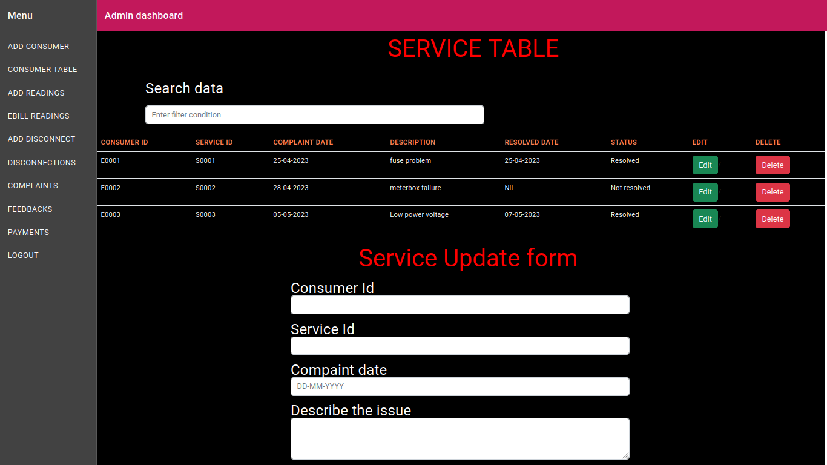
Mepco Schlenk Engineering College (Autonomous)
Service page
Figure 7: Service page
Department of Computer Science and Engineering
<number>

Slide 18
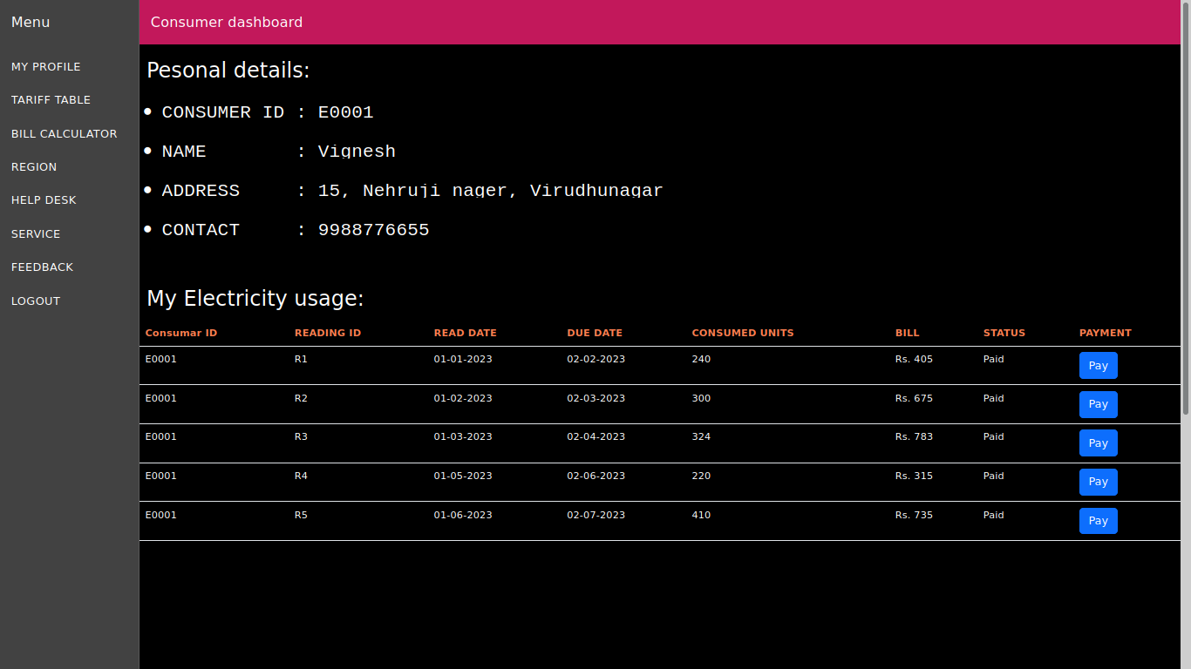
Mepco Schlenk Engineering College (Autonomous)
Consumer dashboard page
Figure 8: Consumer dashboard page
Department of Computer Science and Engineering
<number>

Slide 19
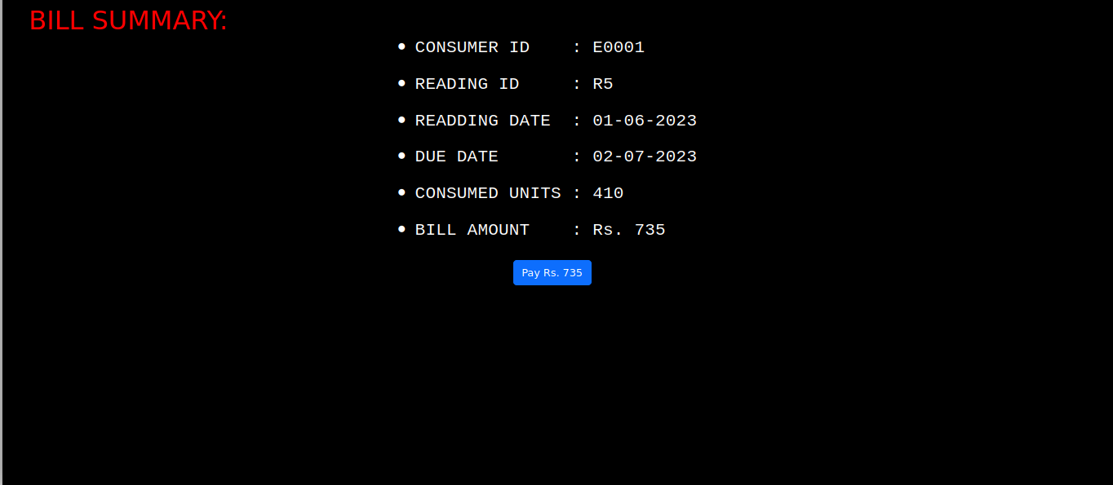
Mepco Schlenk Engineering College (Autonomous)
Payment page
Figure 9: Payment page
Department of Computer Science and Engineering
<number>

Slide 20
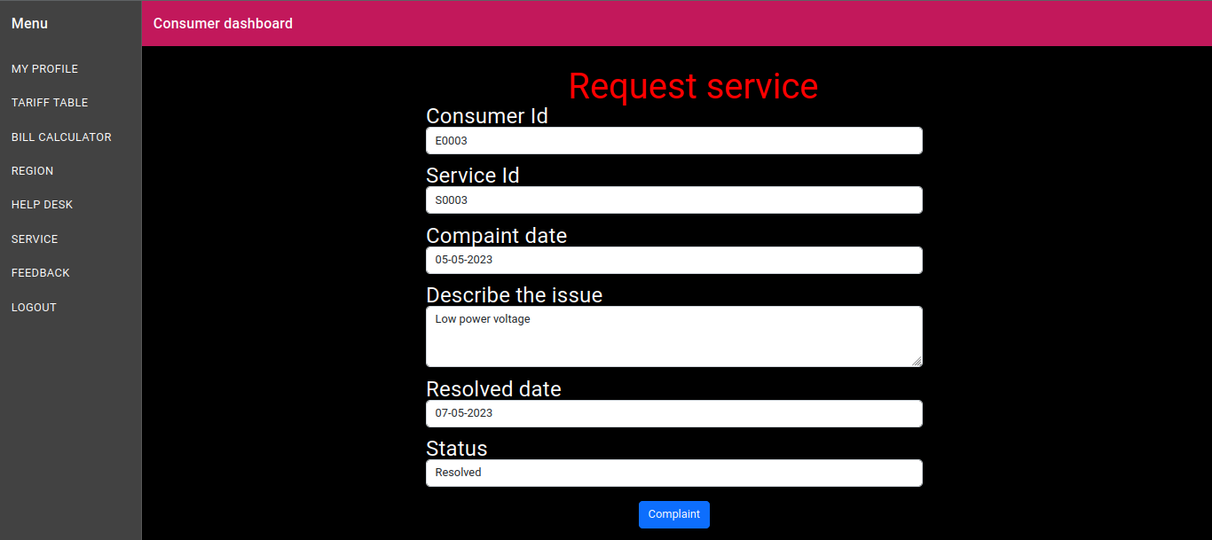
Mepco Schlenk Engineering College (Autonomous)
Request service page
Figure 10: Request service page
Department of Computer Science and Engineering
<number>

Slide 21
Mepco Schlenk Engineering College (Autonomous)
Feedback page
Figure 11: Request service page
Department of Computer Science and Engineering
<number>

Slide 22
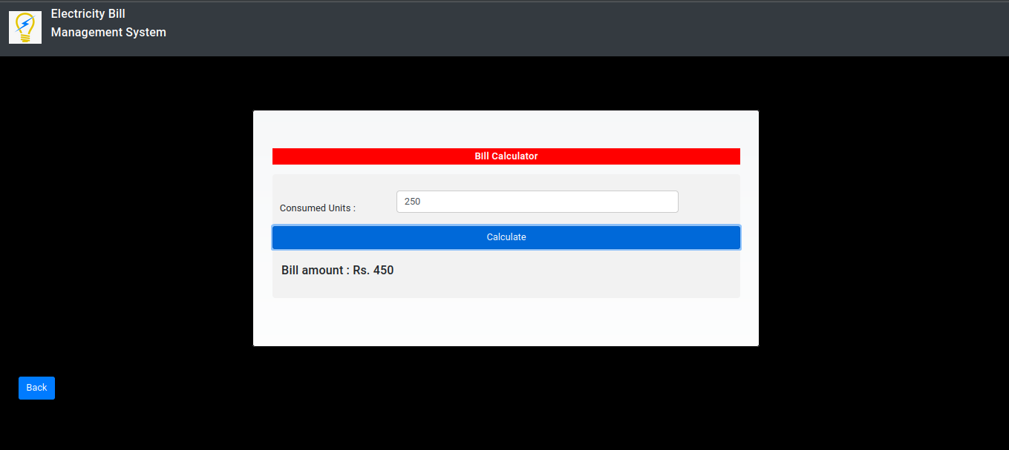
Mepco Schlenk Engineering College (Autonomous)
Bill calculator page
Figure 12: Bill calculator page
Department of Computer Science and Engineering
<number>

Slide 23
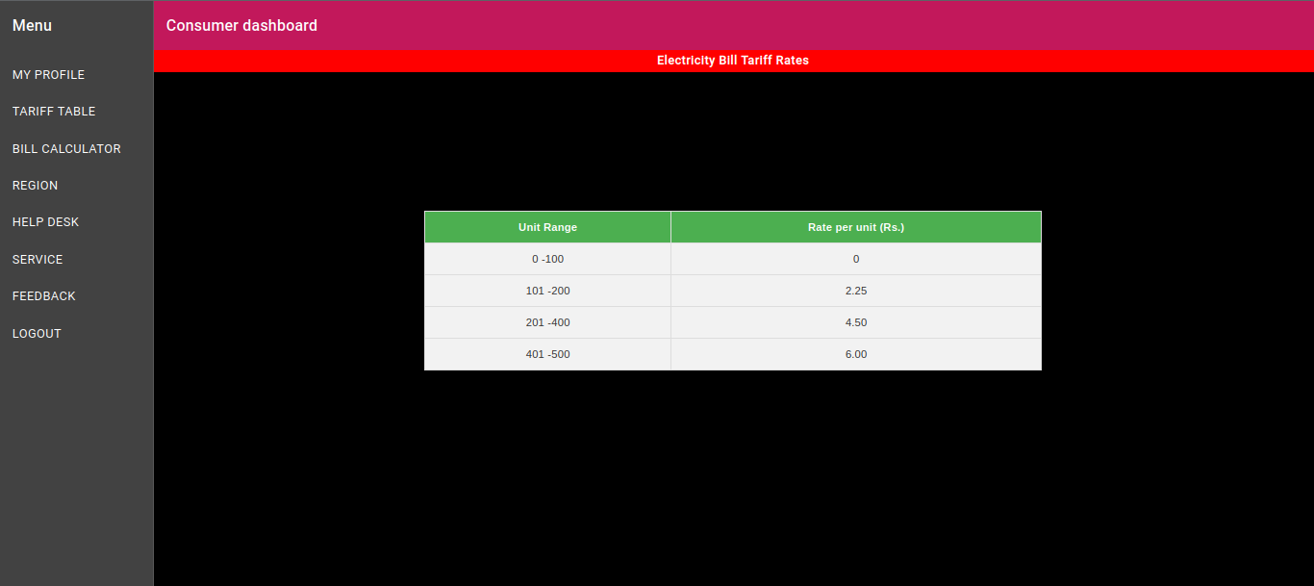
Mepco Schlenk Engineering College (Autonomous)
Tariff page
Figure 13: Tariff page
Department of Computer Science and Engineering
<number>

Slide 24
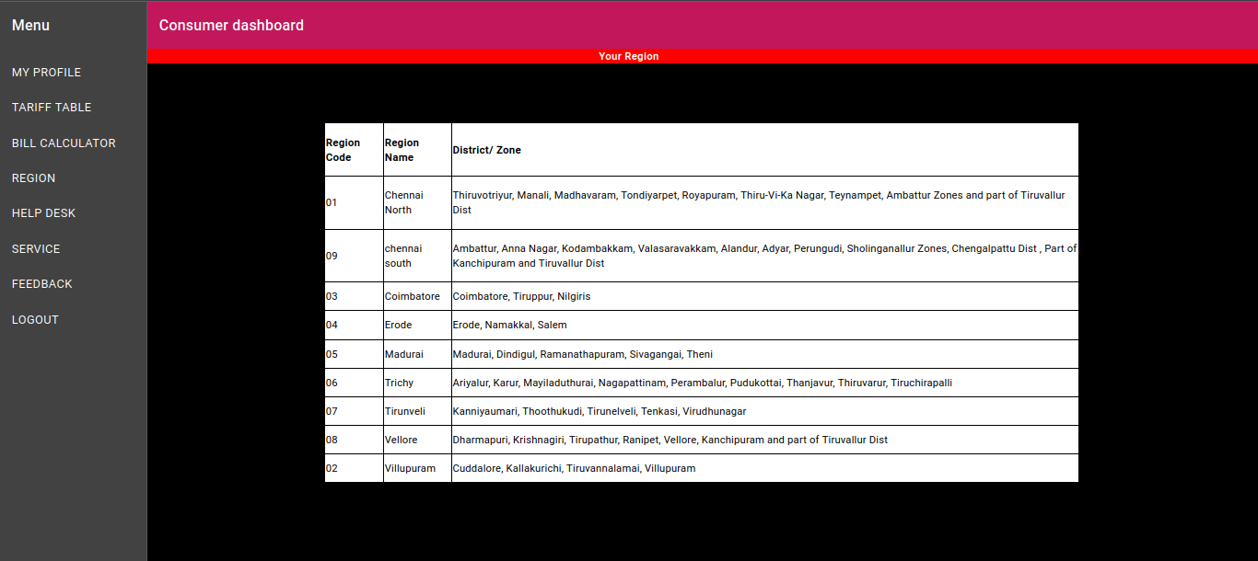
Mepco Schlenk Engineering College (Autonomous)
Region page
Figure 14: Region page
Department of Computer Science and Engineering
<number>

Slide 25
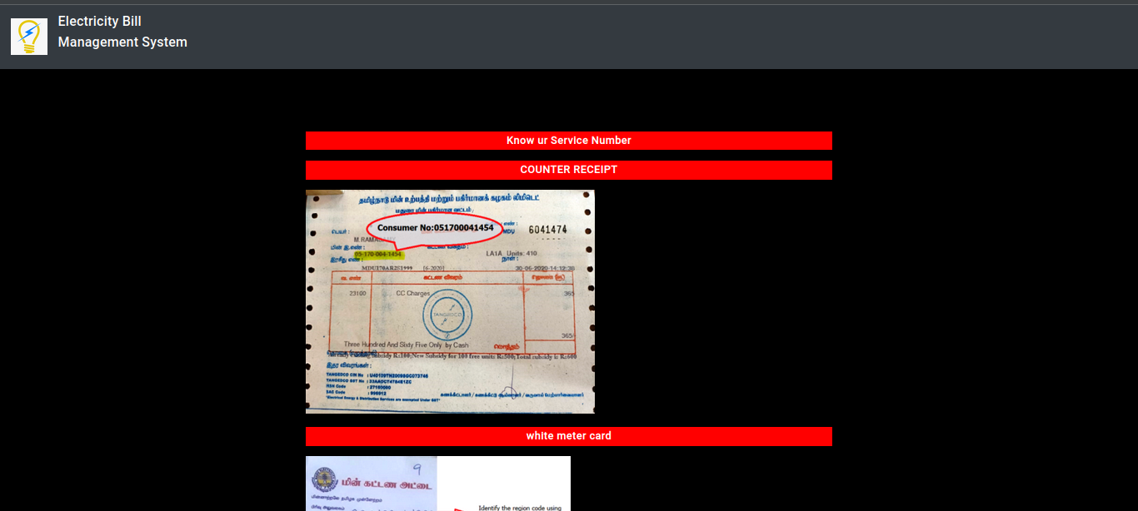
Mepco Schlenk Engineering College (Autonomous)
Helpdesk page
Figure 15: Help desk page
Department of Computer Science and Engineering
<number>

